Slide 1
Neoliberalism in the Caribbean
19 Nov 2019

Slide 2
The debt crisis
Where did current development strategies of attracting foreign investors come from?
  Response to debt crisis of 1980s and its lingering effects

Slide 3
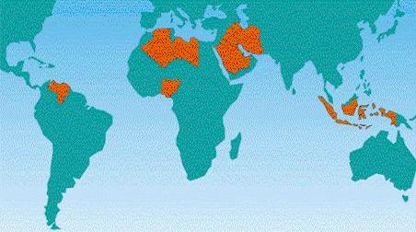
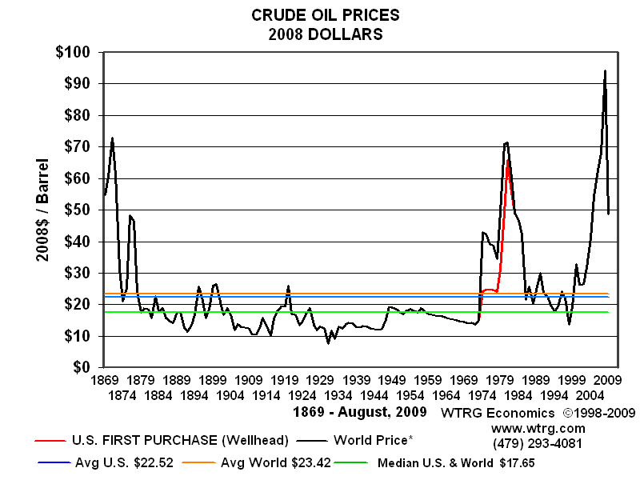
The debt crisis
Context: 1970s
OPEC embargo
  Response to US, European support of Israel
Generated massive stocks of petro-dollars
  Held in European financial institution
European banks looked for outlets for this capital
  Targeted developing country governments
    Infrastructure projects, government bonds, etc.
Loans carried floating interest rates
  Good bargain in the 1970s…
  But left states exposed to interest rate swings….
OPEC Countries (top); oil price fluctuations (bottom)

Slide 4
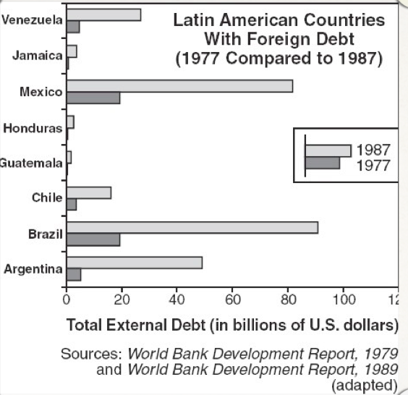
The debt crisis
1980s:
  Reagan administration raises US interest rates to attract foreign capital to the US
  Sends shockwaves through global financial markets
    Interest rates rise swiftly
      Cost of debt increases
    Debt explodes
      3x-4x growth

Slide 5
The debt crisis
Effects on Caribbean economies
  Between 1980 and 1983, major regional economies shrank an average of 17%
    Barbados, DR, Guyana, Haiti, Jamaica, Trinidad & Tobago
  Widespread governmental insolvency by mid 1980s
    Had to turn to the IMF for emergency bailout loans…

Slide 6
Neoliberal solutions to the debt crisis
Structural Adjustment Programs (SAPs)
  Loans came attached with conditionalities
  Cut government budgets
    Layoff government employees
    Reduce social services
  Rollback state regulations
    Remove labor protections, environmental protections
    Privatize industries
    Remove state subsidies for utilities (water, power, transportation…)
  ‘Liberalize’ trade relations
    Reduce tariffs, open markets to imported goods

Slide 7
Neoliberal solutions to the debt crisis
Rationale behind SAPs
  Economic development hindered by state interference in market
  Needed to ‘adjust’ state-market relations (or the underlying ‘structure’ of the economy) to correct this interference
  Development would occur once state interference in market was reduced

Slide 8


Neoliberal solutions to the debt crisis
Neoliberalism
  Specific rationale of state-society relations
  Belief that poverty, economic decline is a result of state interference in markets
  Solutions:
    Privatization
    Free trade
    Deregulation
    Austerity budgeting

Slide 9
Effects of 1980s SAPs
Significant inflation
  Currencies devalued as prices rose
Unemployment increased
  States cut payroll to meet austerity requirements
Higher cost of living
  Consumer goods became more expensive, utilities became more expensive
Cuts to social, public services
  Decline in education, health
    Effects concentrated on poor, women and children
Poor turned to creative means to get by
  ‘Turn hand to make fashion’ – Jamaica
  ‘Reputation’ - Barbados

Slide 10
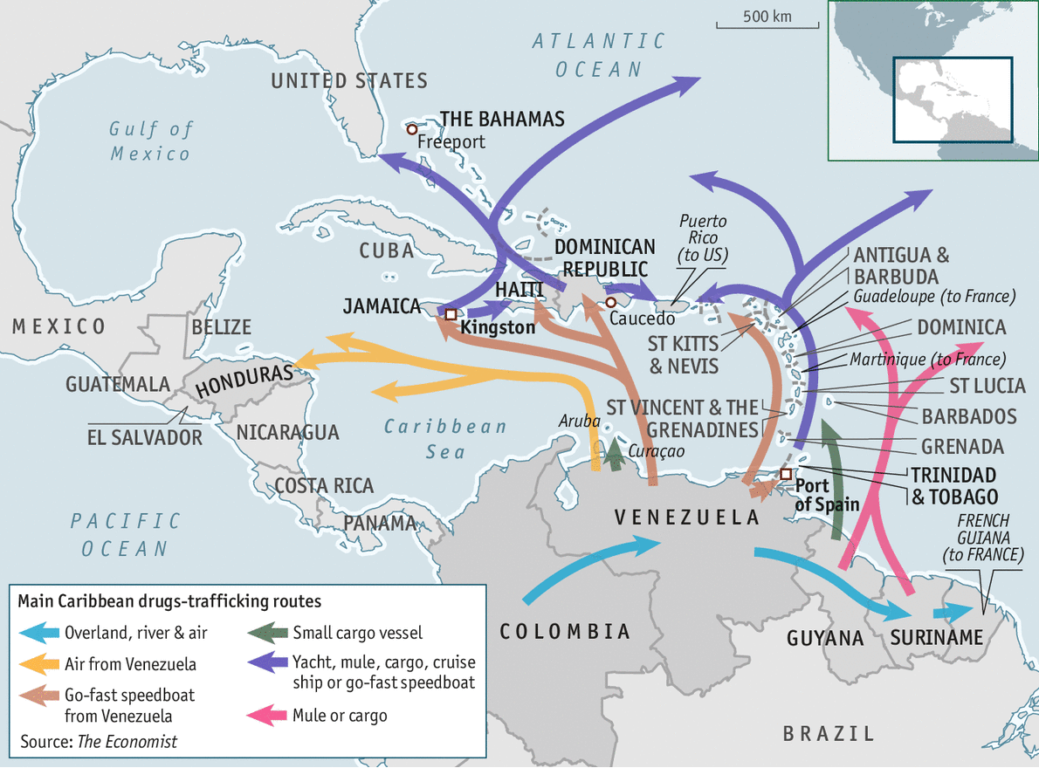
Effects of 1980s SAPs
In Jamaica:
  Austerity programs eroded state resources that could be dedicated to patron-clientelist relations
    State officials didn’t have discretion to award contracts, jobs to supporters
  Dons turned to narcotics and arms trafficking to support

Slide 11
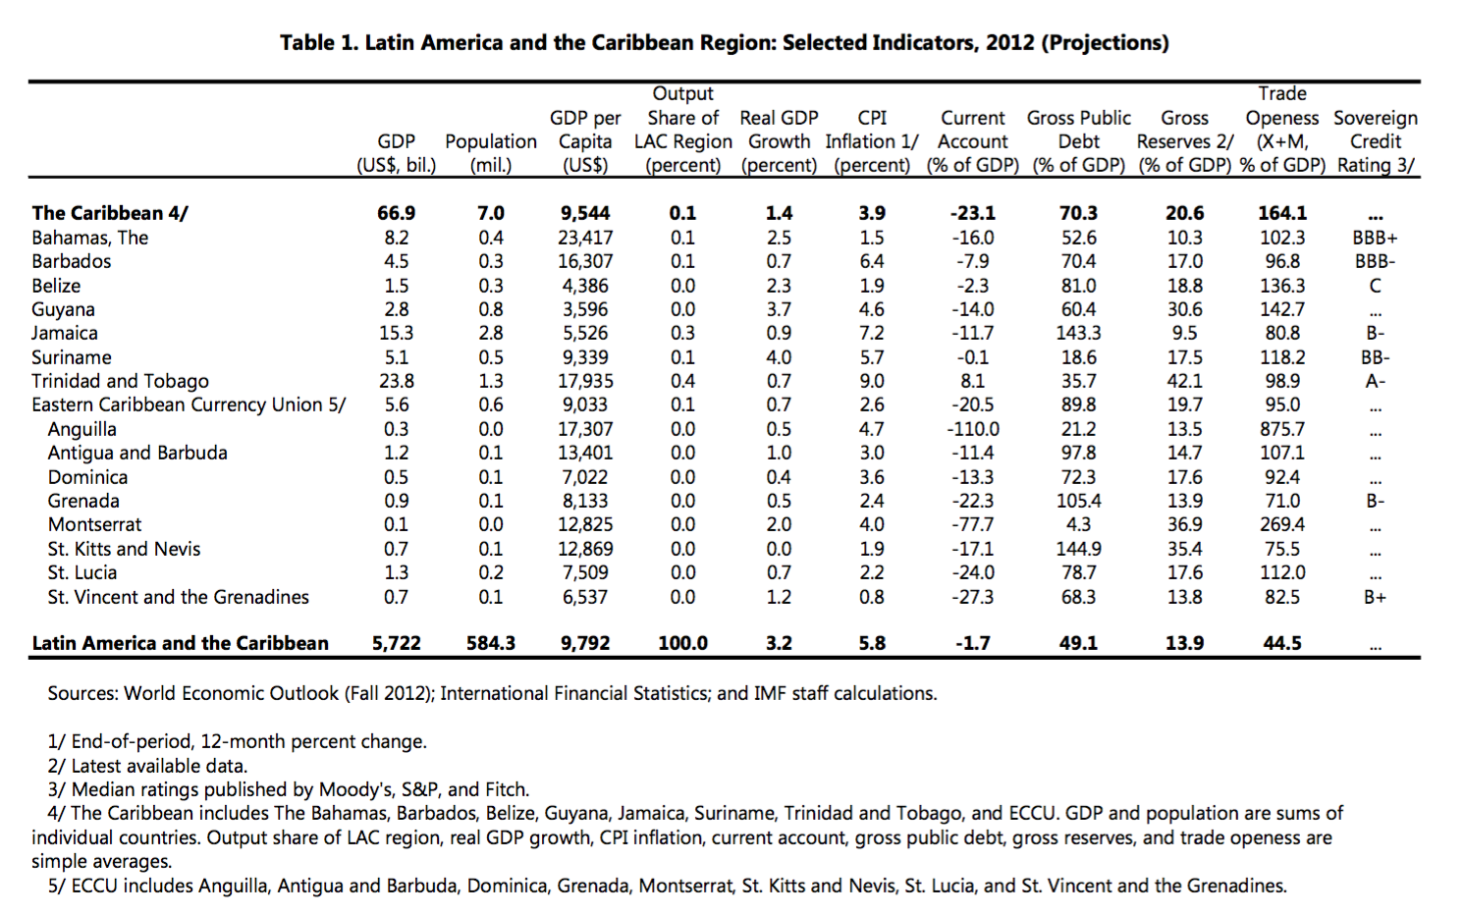
Effects of 1980s SAPs
Development did not follow on as predicted
  Economic growth continued to stagnate or decline
  Debt:GDP ratio increased during the 1980s
    Remains high today

Slide 12
Effects of 1980s SAPs
Homogenized government policies across the region
  Debt will continue to straightjacket government policies
    Need to keep global financial markets happy
    Need to meet conditions of structural adjustment loans

Slide 13
SAPs, round 2…
1990s
  Caribbean governments continued needing bailouts to manage debt
  But SAPs were met with considerable resistance
    Clear that promised development wasn’t materializing
  IMF, World Bank saw governance as the problem
    Governance: structure of state-society-market relations through which policy is developed, implemented
  From 1990s, conditionalities addressed governance structures
  From 2000s, WB began Poverty Reduction Strategies

Slide 14
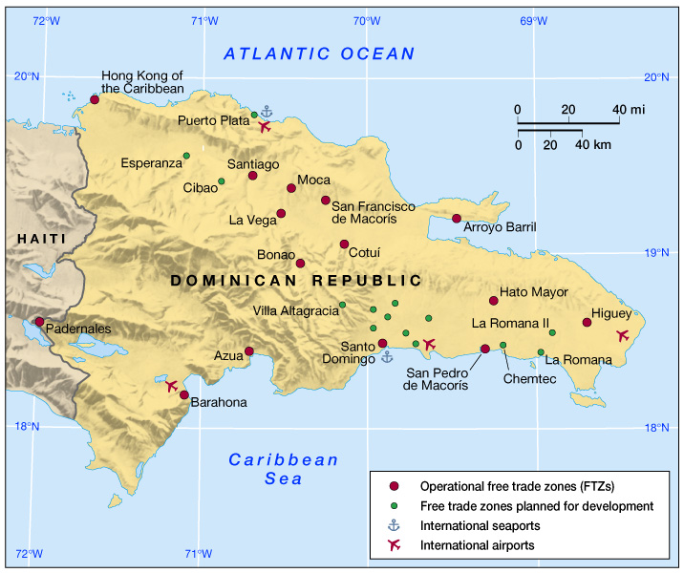
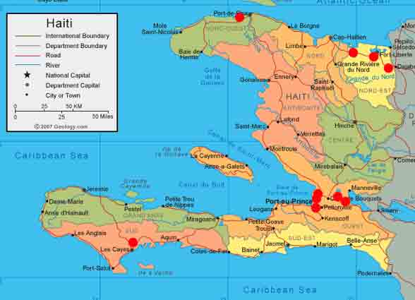
The legacy of SAPs
Caribbean economies in a neoliberal era
  Continued reliance on Western economies
  National economies dominated by:
    Free trade zones
      Assembly, rather than manufacturing
    Offshoring
      Banking, financial services
    Tourism
Free trade zones in the DR (top);
Haiti (bottom)

Slide 15
Legacy of SAPs
Economic weaknesses
  Economies emphasize a few sectors: mining, agriculture, or tourism.
  Manufacturing sector not diverse.
  Highly vulnerable to external decision-making and change, heavily reliant on international trade, and burdened by large foreign debts.
  Wide income disparities.

Slide 16
Effects of neoliberalism
Reconfigured Caribbean economies
  Non-traditional export promotion
    Rather than traditional agricultural/mineral exports
  Export-processing zones
    New territorial arrangements
  Offshore tax havens
    New uses of sovereignty to attract foreign capital
  Tourism
    New sustainable economic strategy

Slide 17
Group Activity (Quiz)
Select one country, and find one news article that details how this country was impacted by neoliberal reforms during the 1990s and 2000s
  Write up a summary of the article and explain how this exemplifies a neoliberal intervention
  Select one student to present a brief summary to the class

